Slide 1
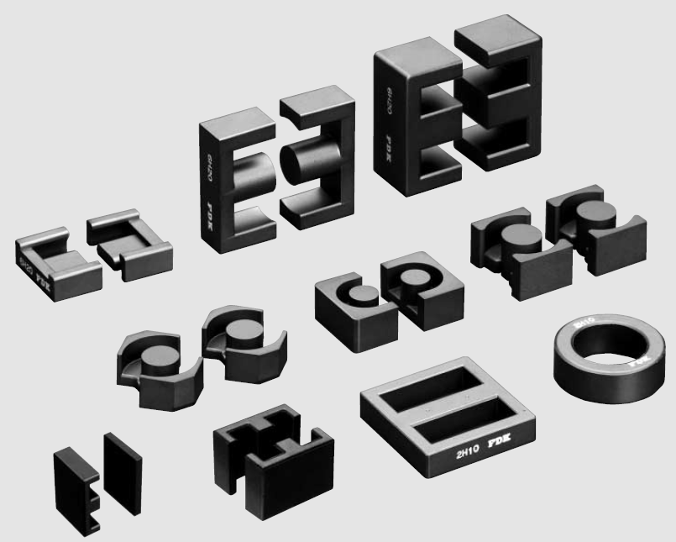
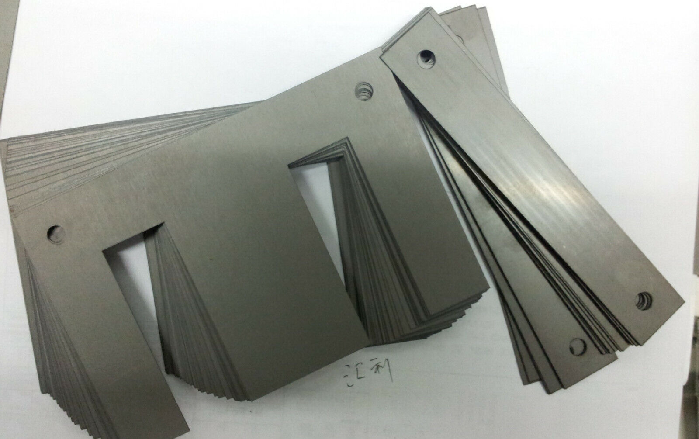
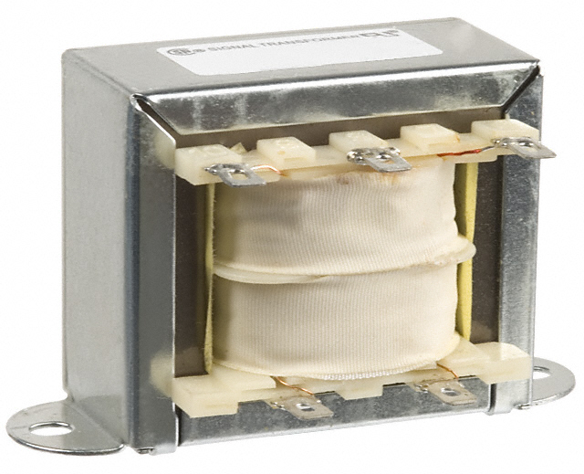
Ferrite cores
Laminated steel cores

Slide 2
Console application: main.py
# Input parameters
mu = 1540.0 # core relative magnetic permeability
g = 0.2 # gap (mm) in the single loop or central part
N = 50 # number of turns of the coil
I = 0.5 # current (A) through the coil
branch = 2 # single loop core (1) or branched core (2)
# If the single loop core (otherwise ignore):
l1 = 0.0 # length of the core in mm
A1 = 0.0 # cross-section of the core in mm^2
# If the branched core (otherwise ignore):
lc = 29.3 # length of the central part in mm
Ac = 123.21 # cross-section of the central part in mm^2
lb = 59.1 # length of each branch part in mm
Ab = 61.605 # cross-section of the branch part in mm^2
N
g
N
g

Slide 3
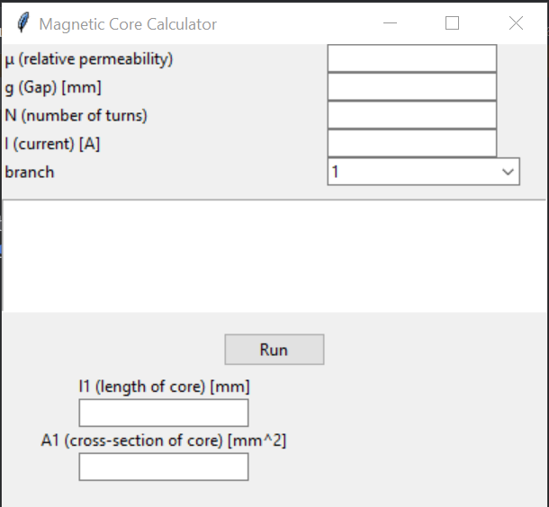
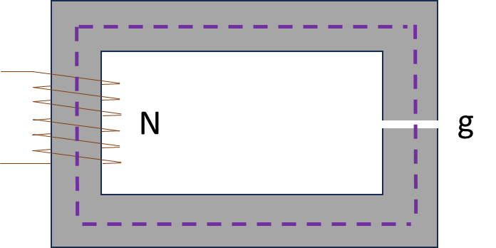
User interface: GUI.py

Slide 4
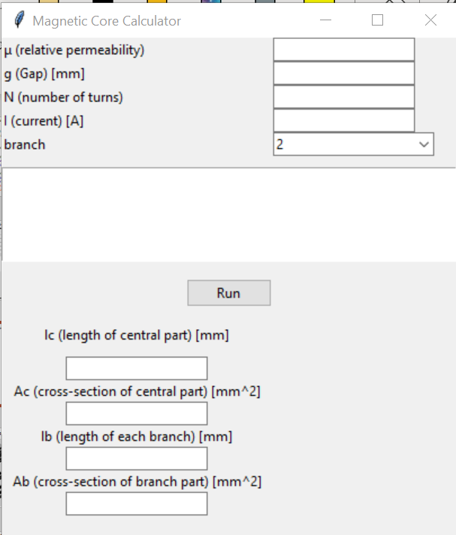
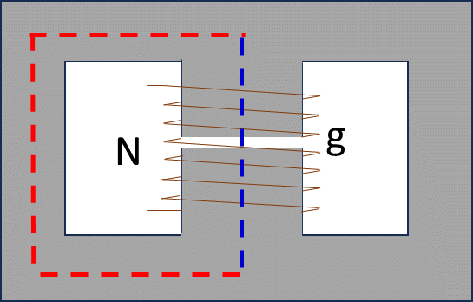
User interface: GUI.py

Slide 5
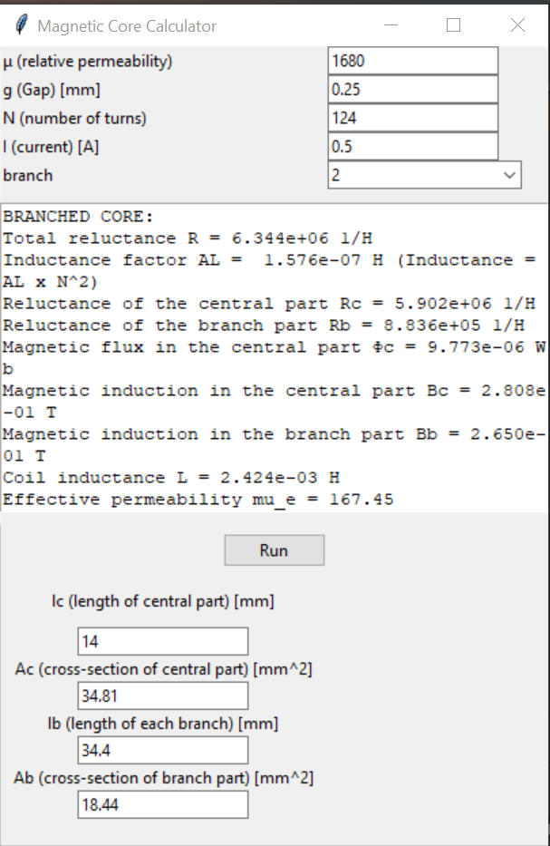
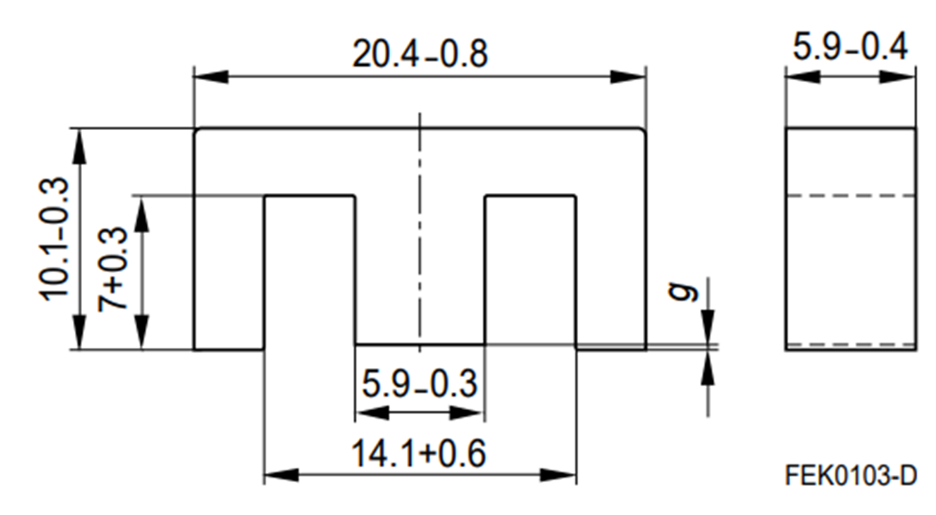
Calculation example: GUI.py

Slide 6
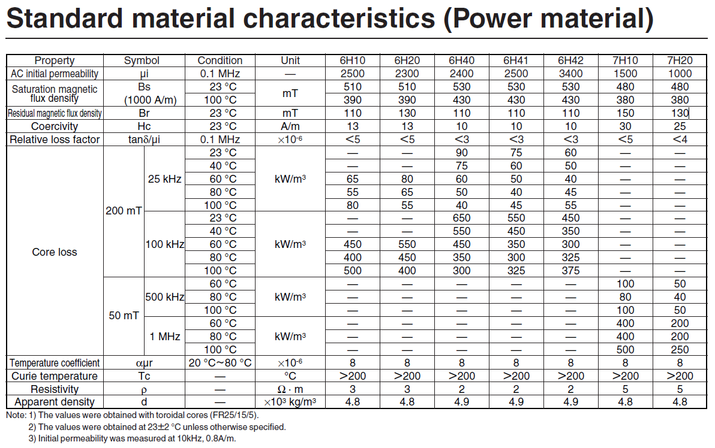
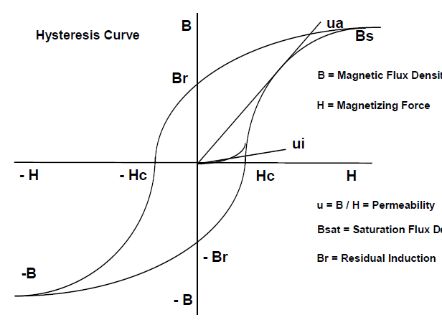
Ferrite cores
Magnetic saturation is an asymptotic state. Therefore, it is indicated for which H (1000 A/m) the induction (flux density) B was measured when approaching its saturation value.
Materials are only ferromagnetic below their corresponding Curie temperatures.

Slide 7
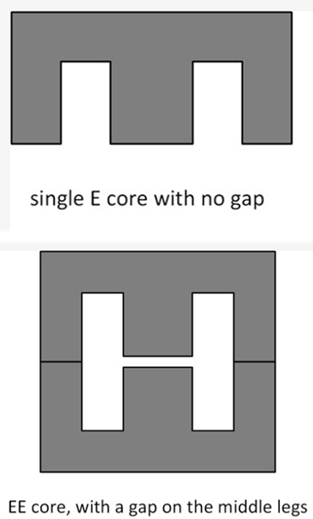
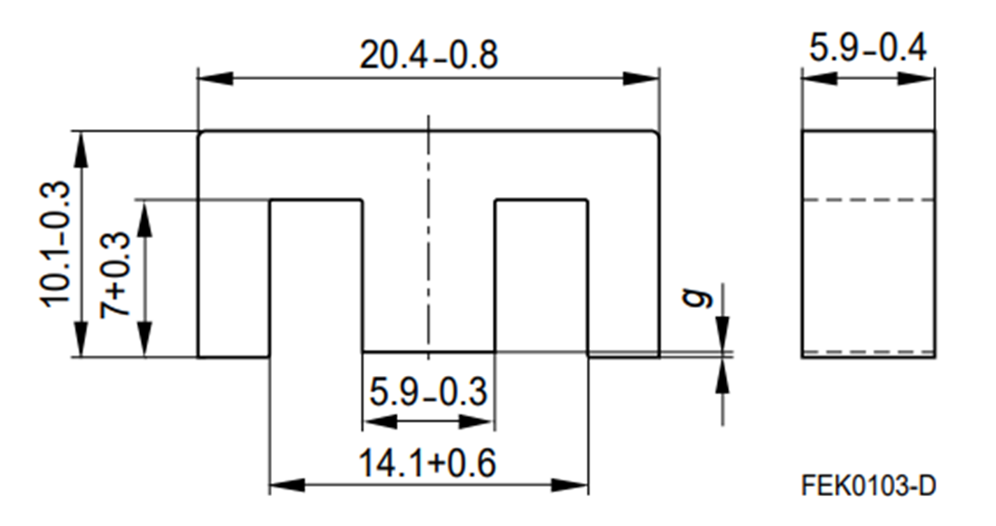
Ferrite E-core used in this case study
https://www.farnell.com/datasheets/1756165.pdf
Ungapped core
Gapped core

Slide 8
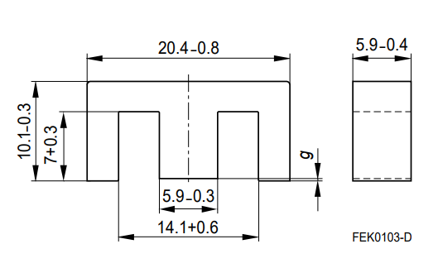
Design equations and magnetic circuit segments
− reluctance (H⁻¹) of a magnetic segment with a length l_{i} and cross-section S_{i}
MMF – magnetomotive force (Amperes × turns)
− magnetic flux (Weber, Wb) calculated in a single loop core
In a branched core, Φ is calculated using KVL & KCL
− induction or flux density (Tesla, T)
− magnetising force (A/m)
− inductance (Henry, H)

Slide 9
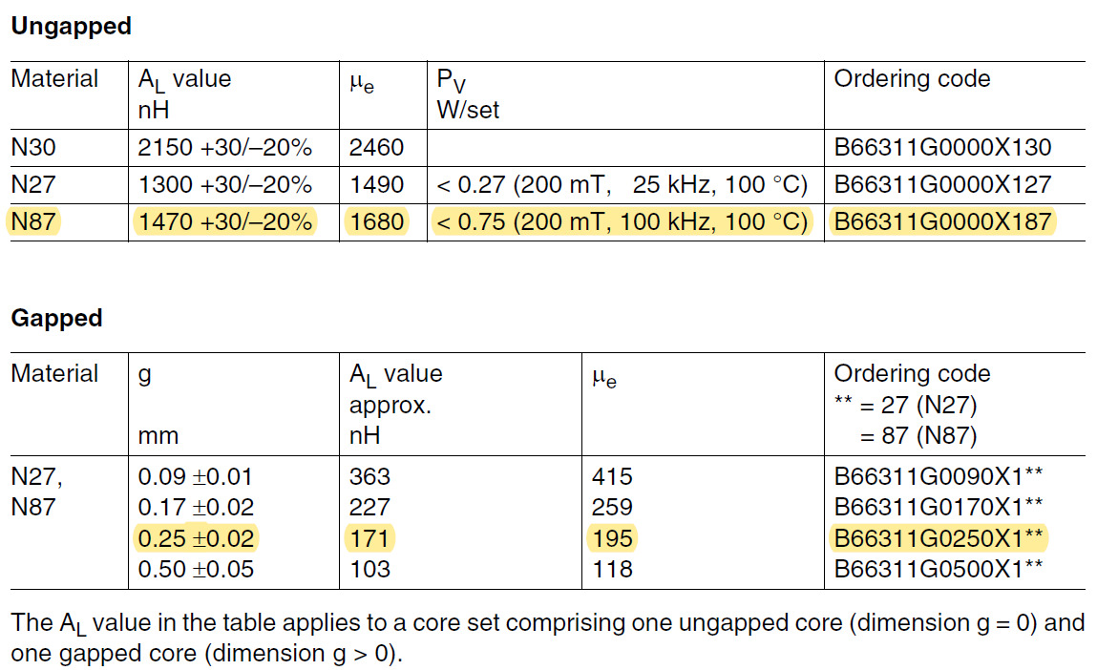
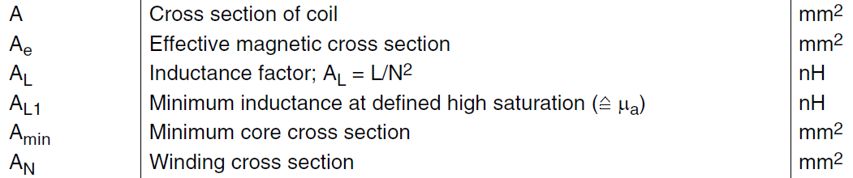
https://www.farnell.com/datasheets/1756165.pdf
Total gap!

Slide 10
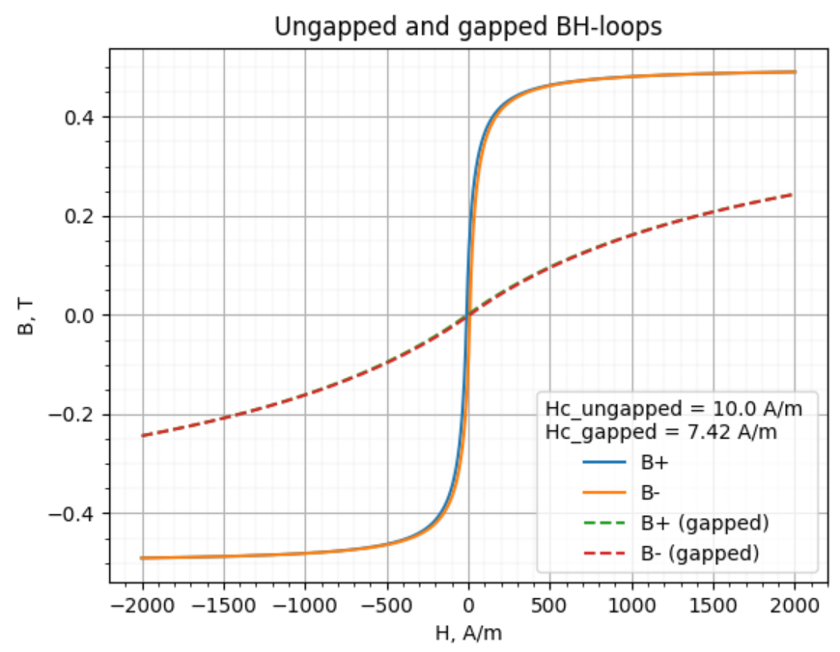
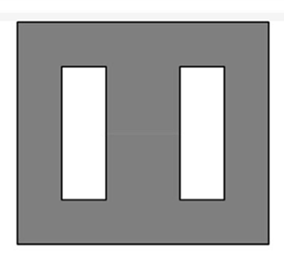
The saturation properties of a magnetic core are equally if not more important than dimensions, A_{L} value (see the previous slide) and core loss and should also be specified measured and monitored. In many applications if the core saturates, the inductance and impedance of the component decreases and causes the circuit currents to escalate. Excessive currents can cause other circuit components (semiconductor switches, diodes, capacitors) to fail. The saturated core is hard to determine as the root cause since this failure mode typically exhibits no permanent damage to the ferrite core and the magnetic component.
Chan’s BH-loop model
The slope of flux density (B) divided by magnetizing force (H) is the effective permeability. Permeability is a material’s ability to conduct magnetic flux relative to air and is proportional to a component’s inductance. Note that as the material saturates the slope of B/H decreases, thus the inductance of a component decreases. Introducing an air gap in the magnetic flux path sheers the hysteresis loop so that it requires more magnetizing force to saturate the core. The more air gap introduced into the flux path the lower the permeability (ratio of B/H). Note that the saturation flux density is unchanged even though a gapped core requires more magnetizing force before reaching saturation.

Slide 11
Estimated cross-sections
18.59 mm²
18.29 mm²
34.81 mm²

Slide 12
Reluctances of three segments in the magnetic E-core
18.59 mm²
18.29 mm²
34.81 mm²

Slide 13
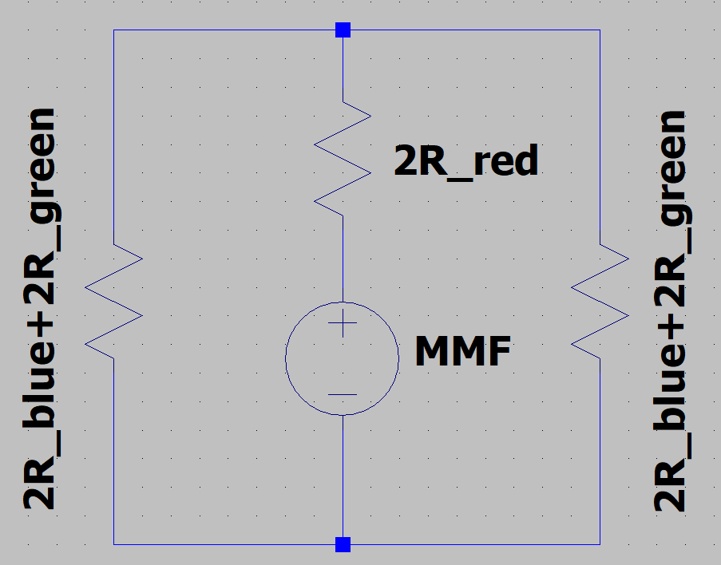
Equivalent electrical circuit

Slide 14

$$For N=124:18.1 mH<L<29.38 mH$$
The calculated value is in the middle of the tolerance interval

Slide 15
18.59 mm²
18.29 mm²
34.81 mm²
Total symmetrical gap!

Slide 16
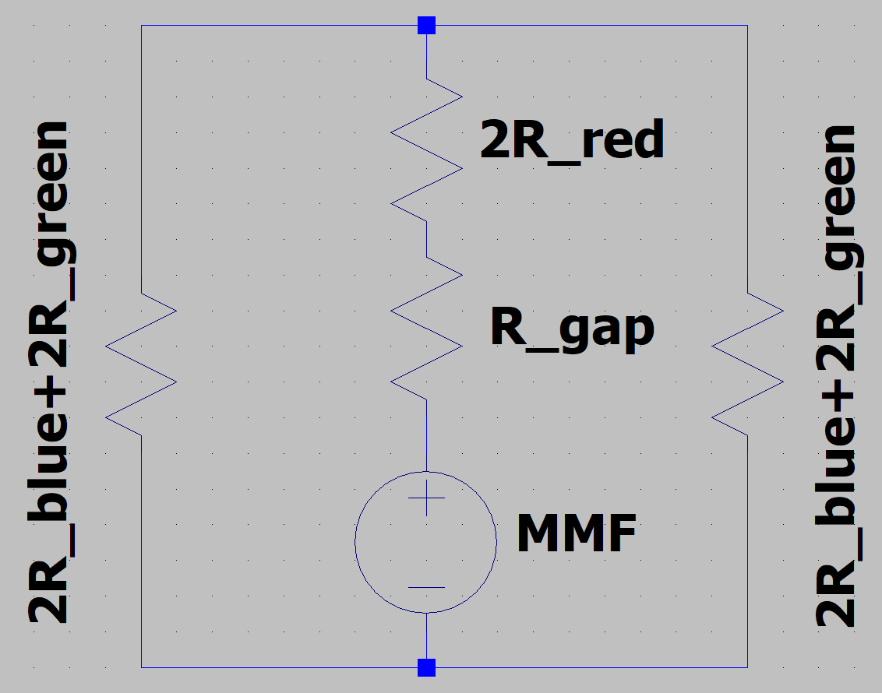
Equivalent electrical circuit

Slide 17

$$For N=124:L=2.63 mH$$

Slide 18
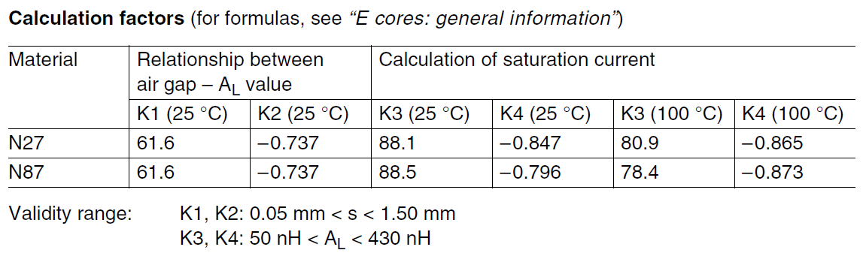
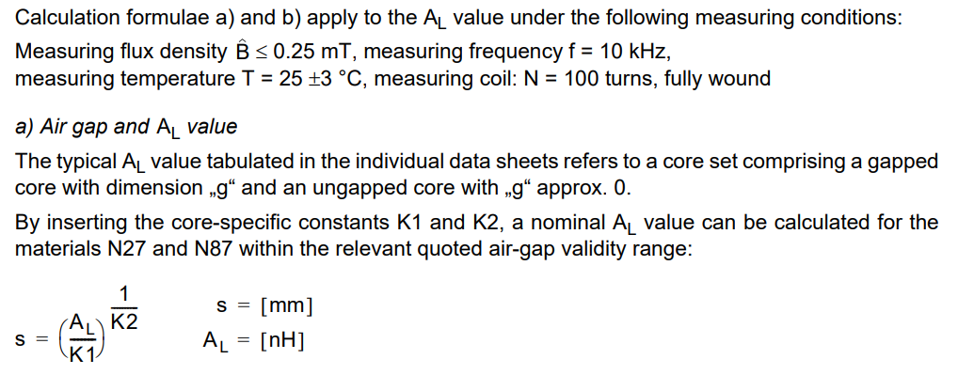
https://www.farnell.com/datasheets/1756165.pdf

Slide 19
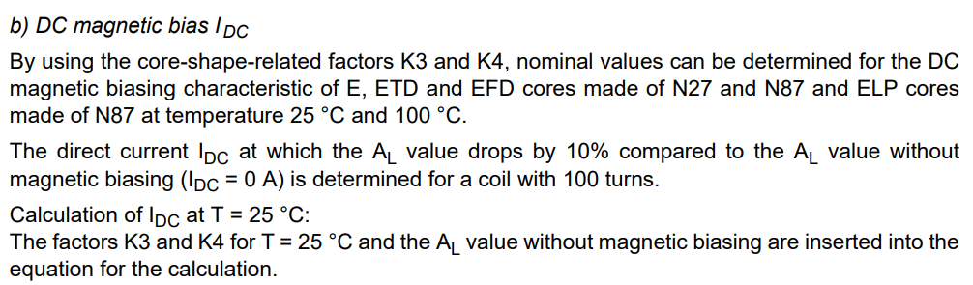
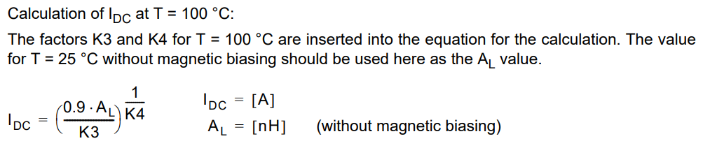

https://www.farnell.com/datasheets/1756165.pdf
$$For A_{L}=171 \left(gapped\right) and N=100: I_{DC}≈0.5 A$$

Slide 20
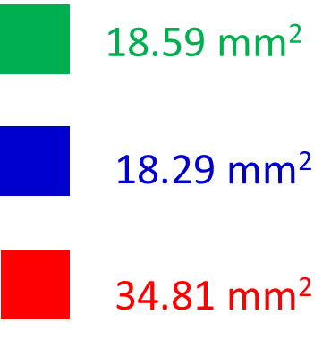

$$I=0.5 A −beggining of the saturation$$
All parts are approximately at the same magnetic condition

